Slide 1

Modeling Food Attributes as a Multiplex Network to Understand Preference-Based Multi-Attribute Decision-Making
Raman Ebrahimi, Kianté Fernandez,
Department of Electrical and Computer Engineering,
The Ohio State University
Department of Psychology,
The Ohio State University

Slide 2
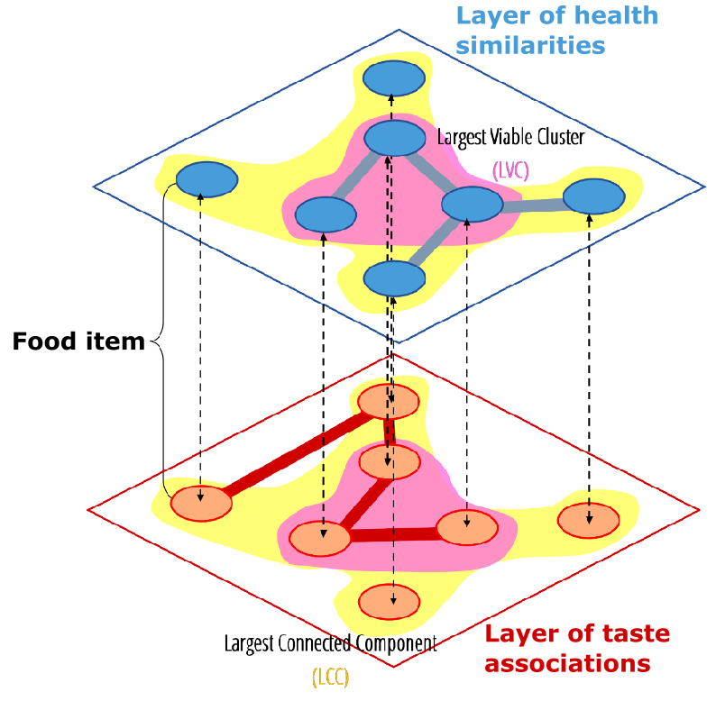
What
To build a multiplex representation of food attributes to further explain preference-based multi-attribute decision-making. We aim to demonstrate how accounting for patterns within multiplex networks can capture what could not be observed in single-layer networks alone.

Slide 3
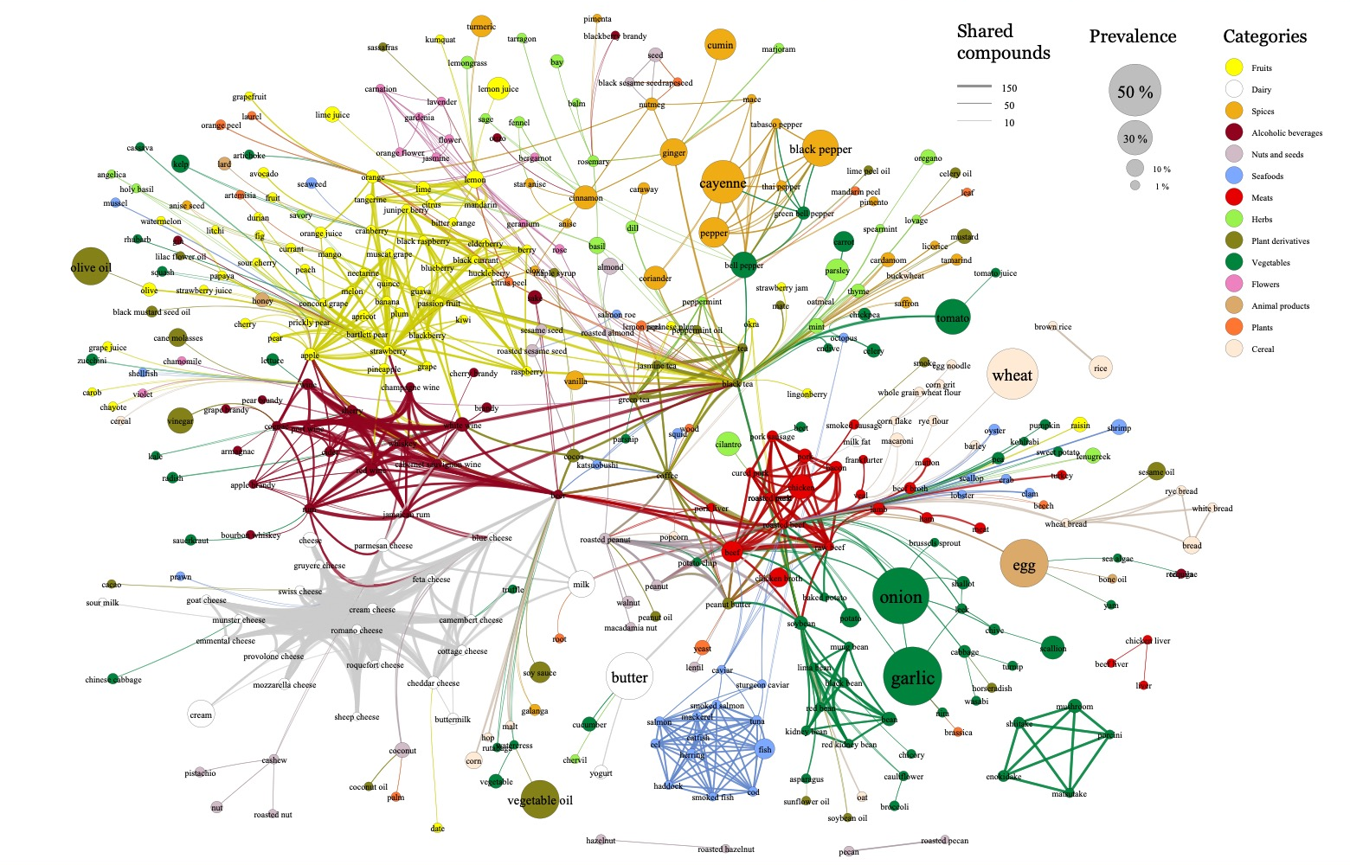
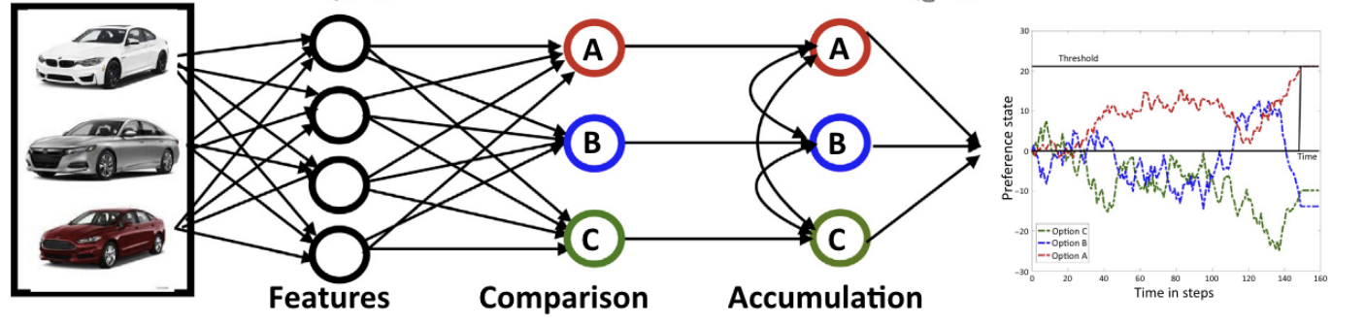
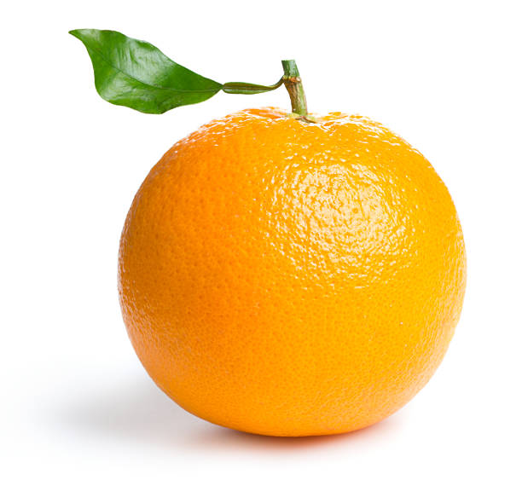
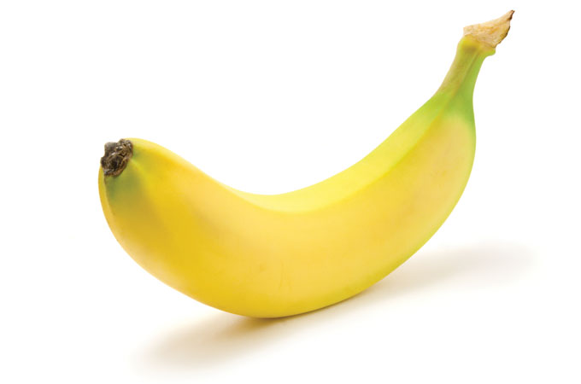
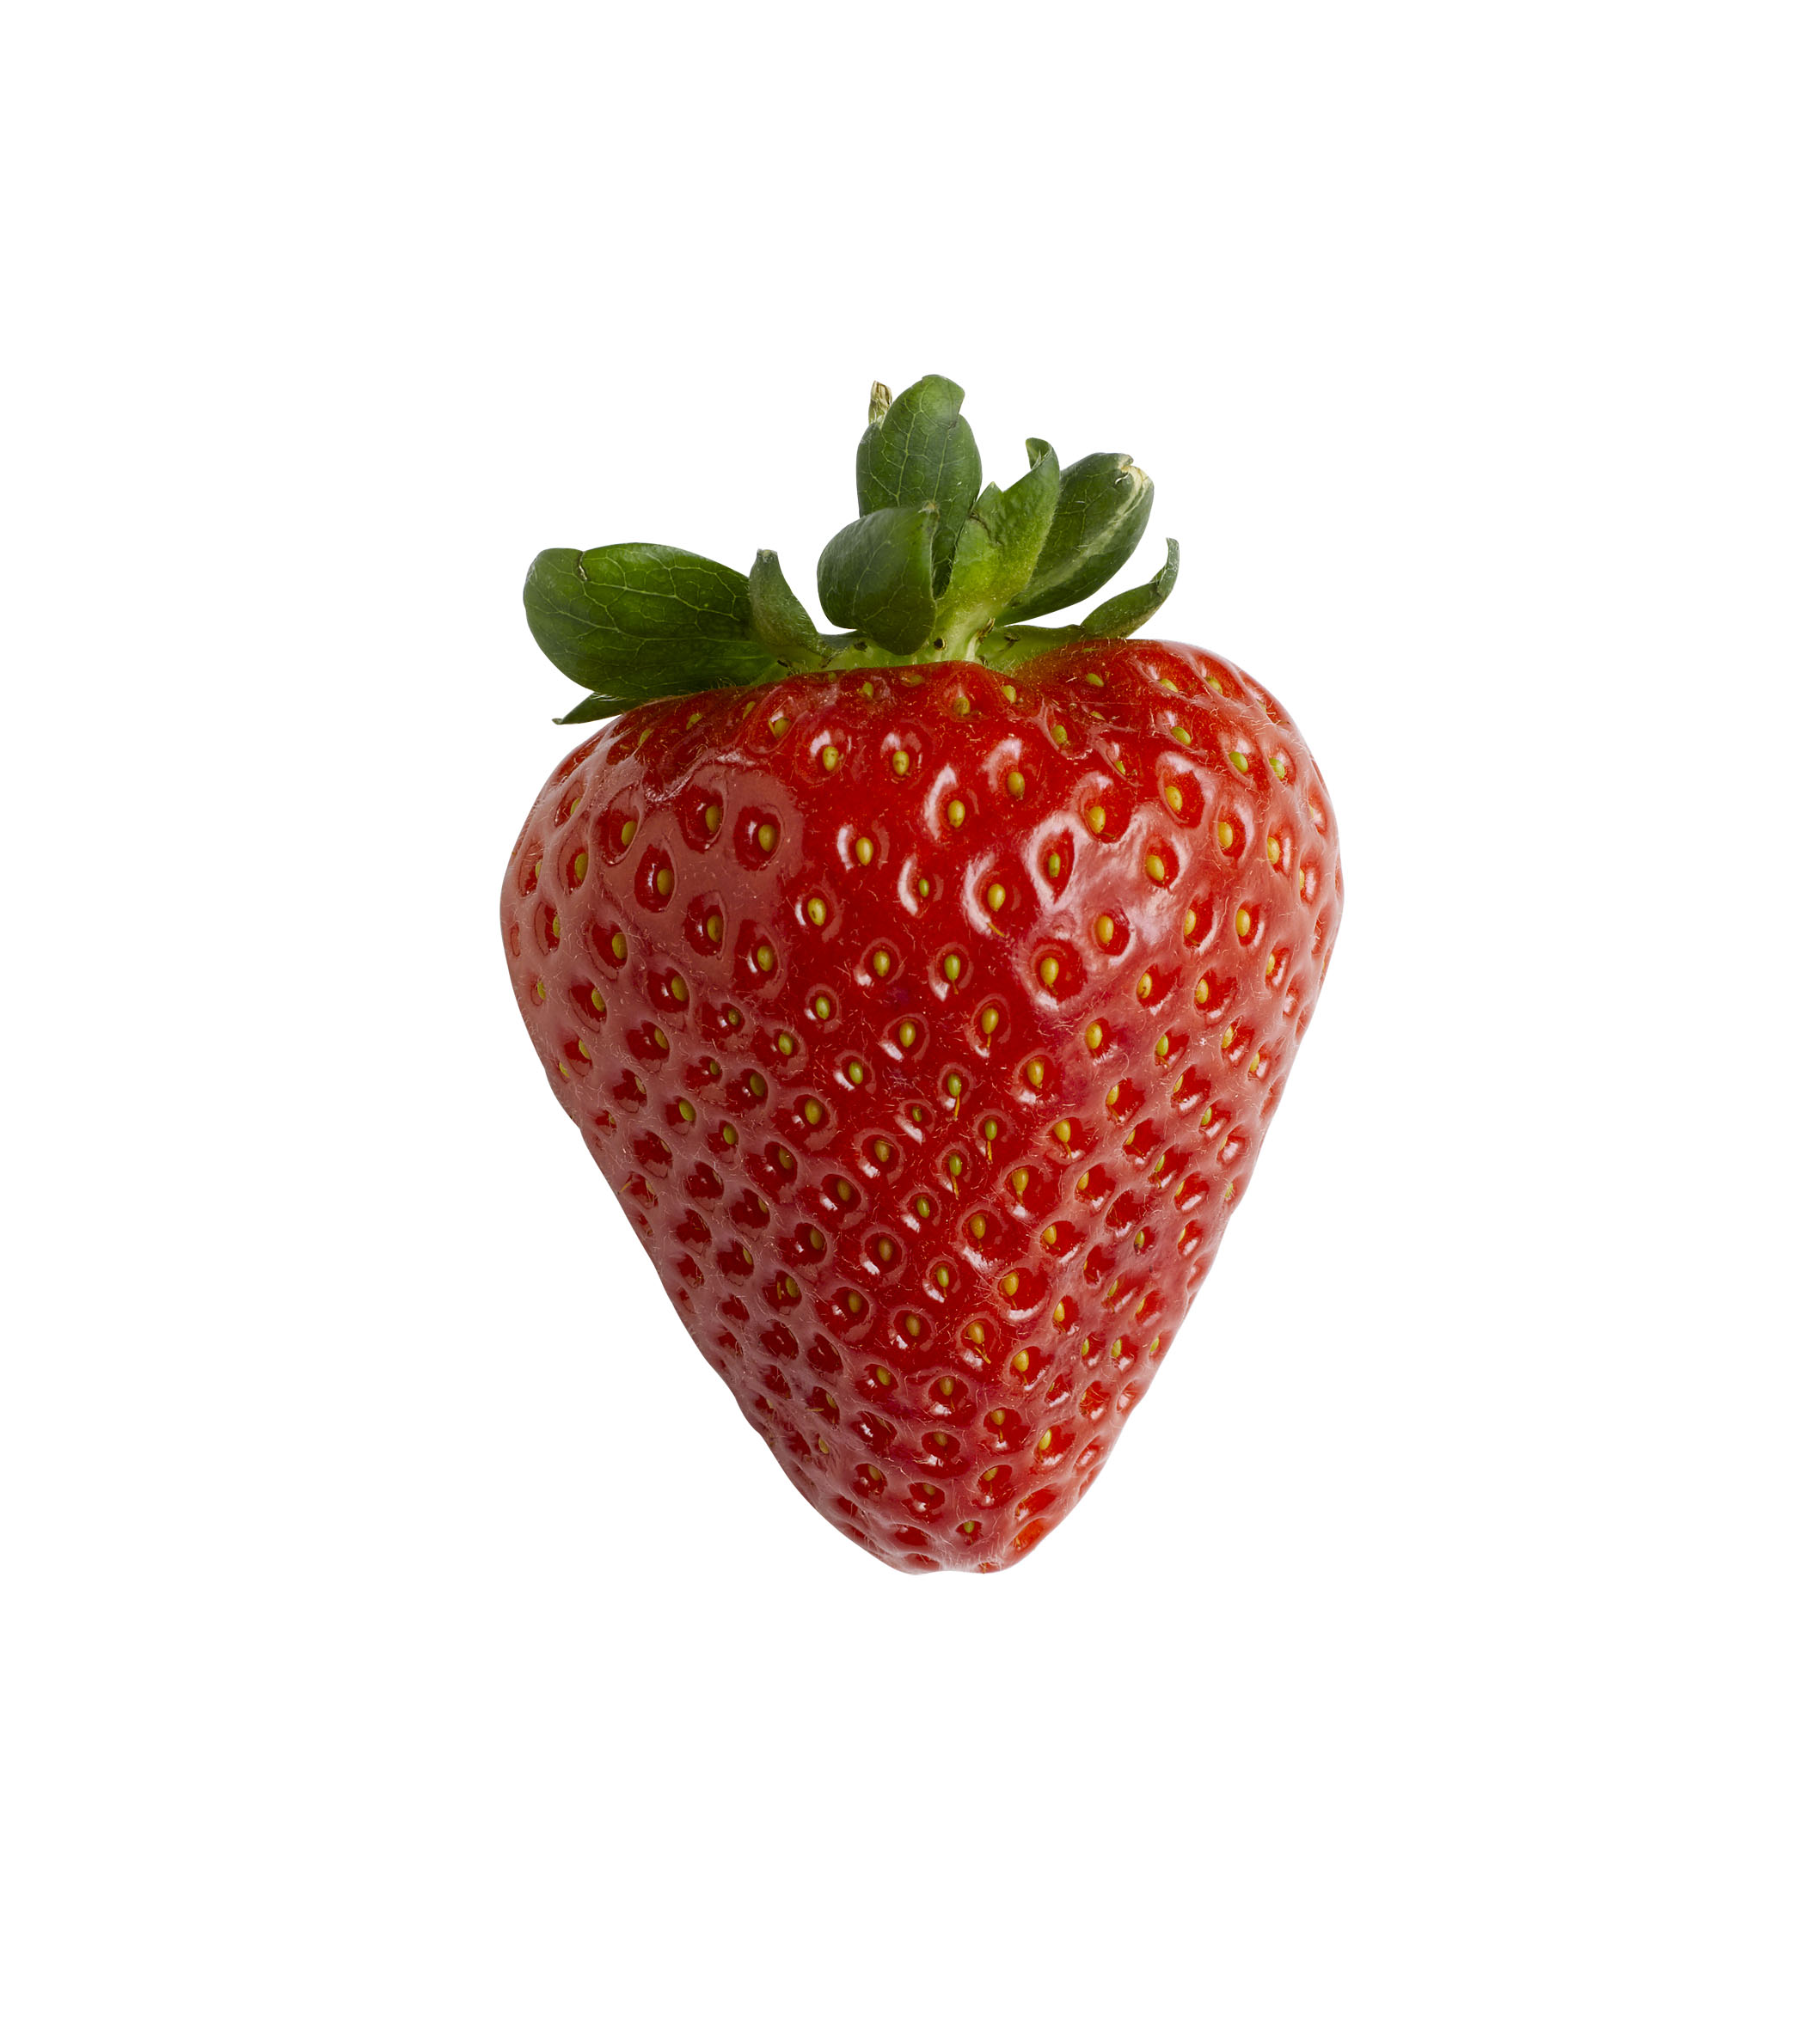
Why
Food has many attributes
Preference-based Multi-attribute Decision making
a new lens for understanding how individuals evaluate and make decisions about food
Notes:
refers to making preference decisions by evaluating and prioritizing a limited set of alternatives based on multiple conflict attributes

Slide 4

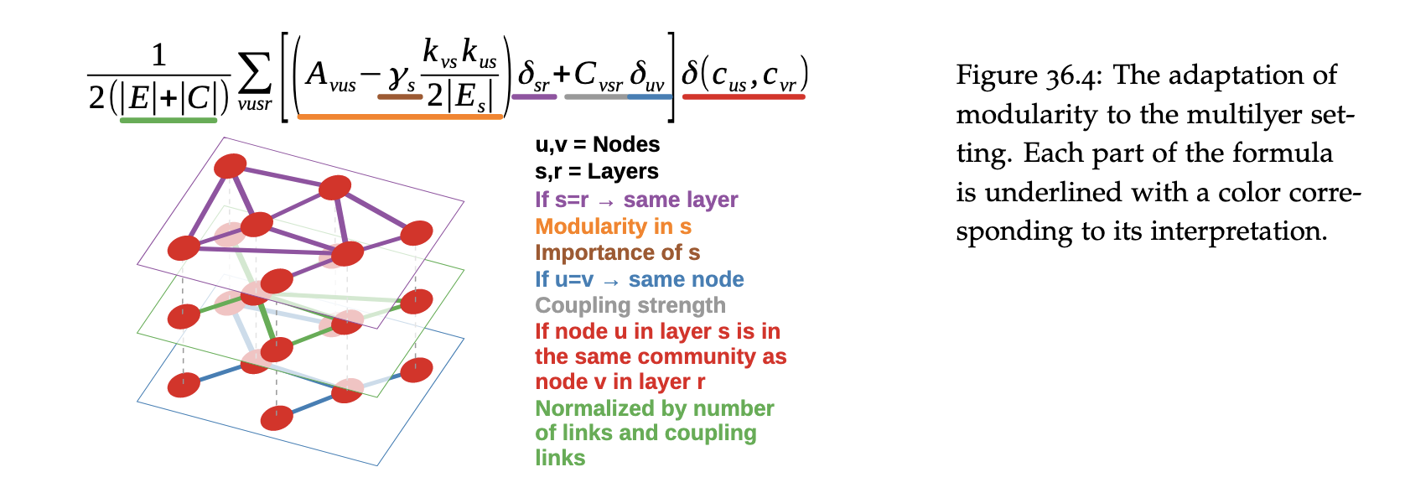


How
Rich data sources for food-related research
Multi-layer community detection
Notes:
The adaptation of modularity to the multilyer set-ting. Each part of the formula is underlined with a color corresponding to its interpretation

Slide 5


Thanks

